Slide 1
USII.4b and USII.4d-e
Immigration & Growth of Cities; Inventions, Big Business, & Industry; Progressive Movement

Slide 2
USII.4b Immigration & Growth of Cities
After the end of the Civil War population changes, growth of cities, and new inventions produced interaction and often conflict between different cultural groups and in urban areas.

Slide 3
USII.4b Immigration & Growth of Cities
One of the reasons for population change was the rise of immigration. The number of immigrants coming to America increased because of the following reasons:
• Religious freedom
• Escape from oppressive governments
• Adventure
• Looking for better opportunities

Slide 4
USII.4b Immigration & Growth of Cities
With the growth of population also came the growth and development of cities. Immigrants were not the only people moving to cities. Many Americans moved from rural to urban areas for job opportunities in specialized industries such as steel and meat packing.

Slide 5
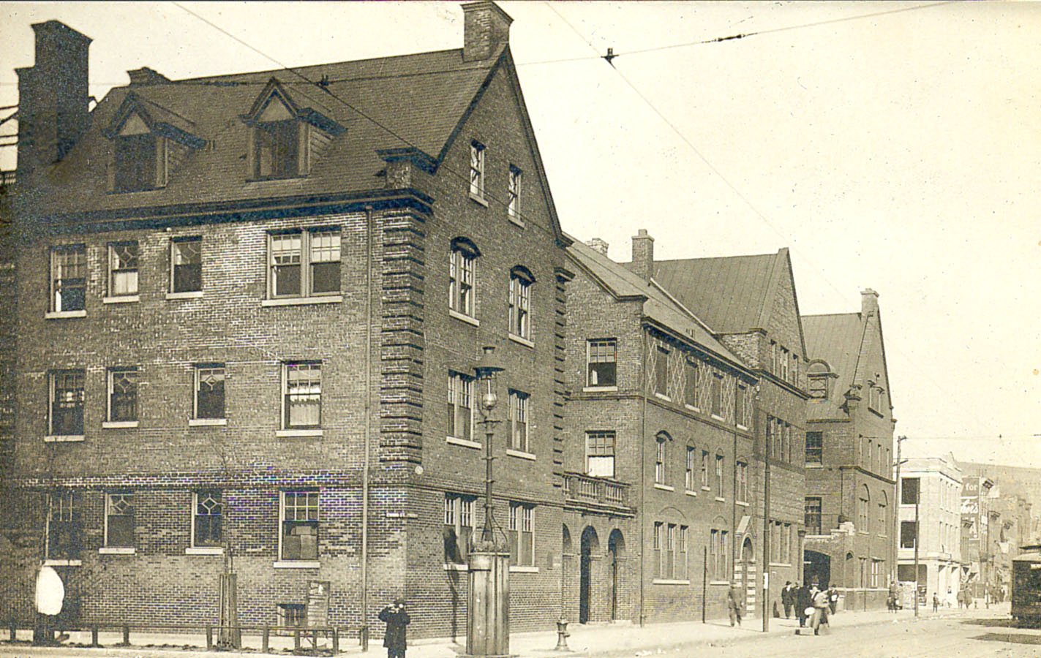
USII.4b Immigration & Growth of Cities
Not all of the growth was positive. Rapid industrialization and urbanization led to overcrowded immigrant neighborhoods (ghettos) and tenements. Settlement houses, such as the Hull House (founded by Jane Addams), were very important. Settlement houses provided aid to many immigrants living with unsanitary conditions.

Slide 6
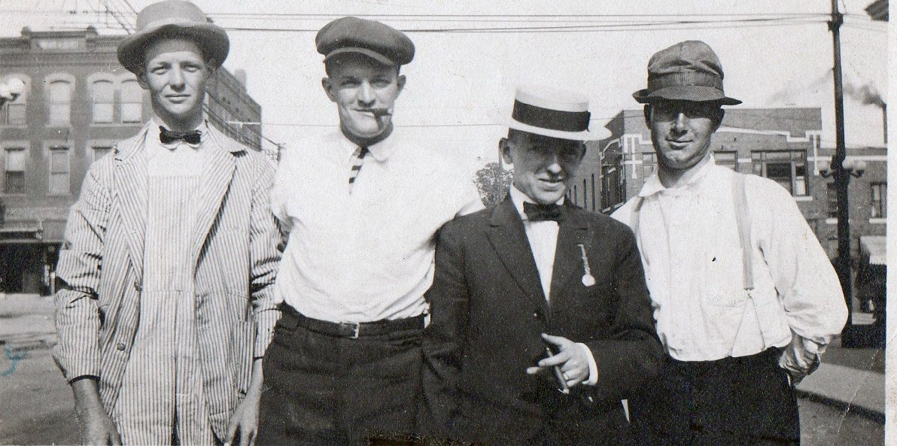
USII.4b Immigration & Growth of Cities
Most immigrants were discriminated against. The Chinese (Angel Island) and the Irish (Ellis Island) were treated the worst. Unfortunately, many corrupt political machines gained power by lying about attending to the needs of new immigrants (jobs, housing, etc).

Slide 7
USII.4d Inventions, Big Business, Industry
Between the Civil War and World War I, the United States was transformed from an agricultural to an industrial nation. New inventions contributed to the United States’ transformation. Mechanization of farms reduced farm labor needs and increased production. Industrial development in cities created increased labor needs and industrialization provided new access to consumer goods (mail order).

Slide 8
USII.4d Inventions, Big Business, Industry
Factors that resulted in the growth of industry included:
• Access to raw materials and energy
• Availability of work force due to immigration
• Inventions
• Financial resources

Slide 9
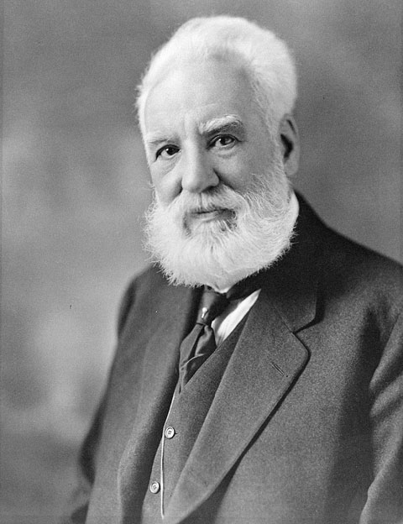
USII.4d Inventions, Big Business, Industry
The two main inventions that led to industrial growth and great change in America were:
• Electric lighting and use of electricity (Thomas Edison)
• Telephone (Alexander Graham Bell)

Slide 10
USII.4d Inventions, Big Business, Industry
Industrial growth eventually led to the prosperity of big business. National markets that created transportation advances, advertising, and lower-cost production were three of the major reasons why industrial growth happened so quickly in America.

Slide 11
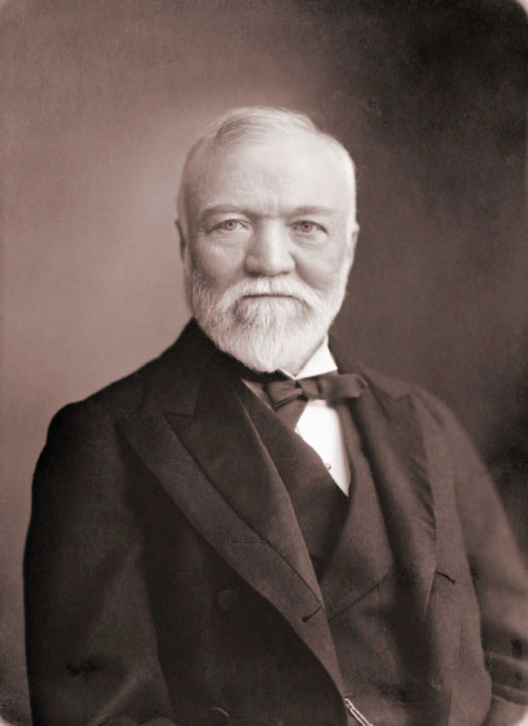
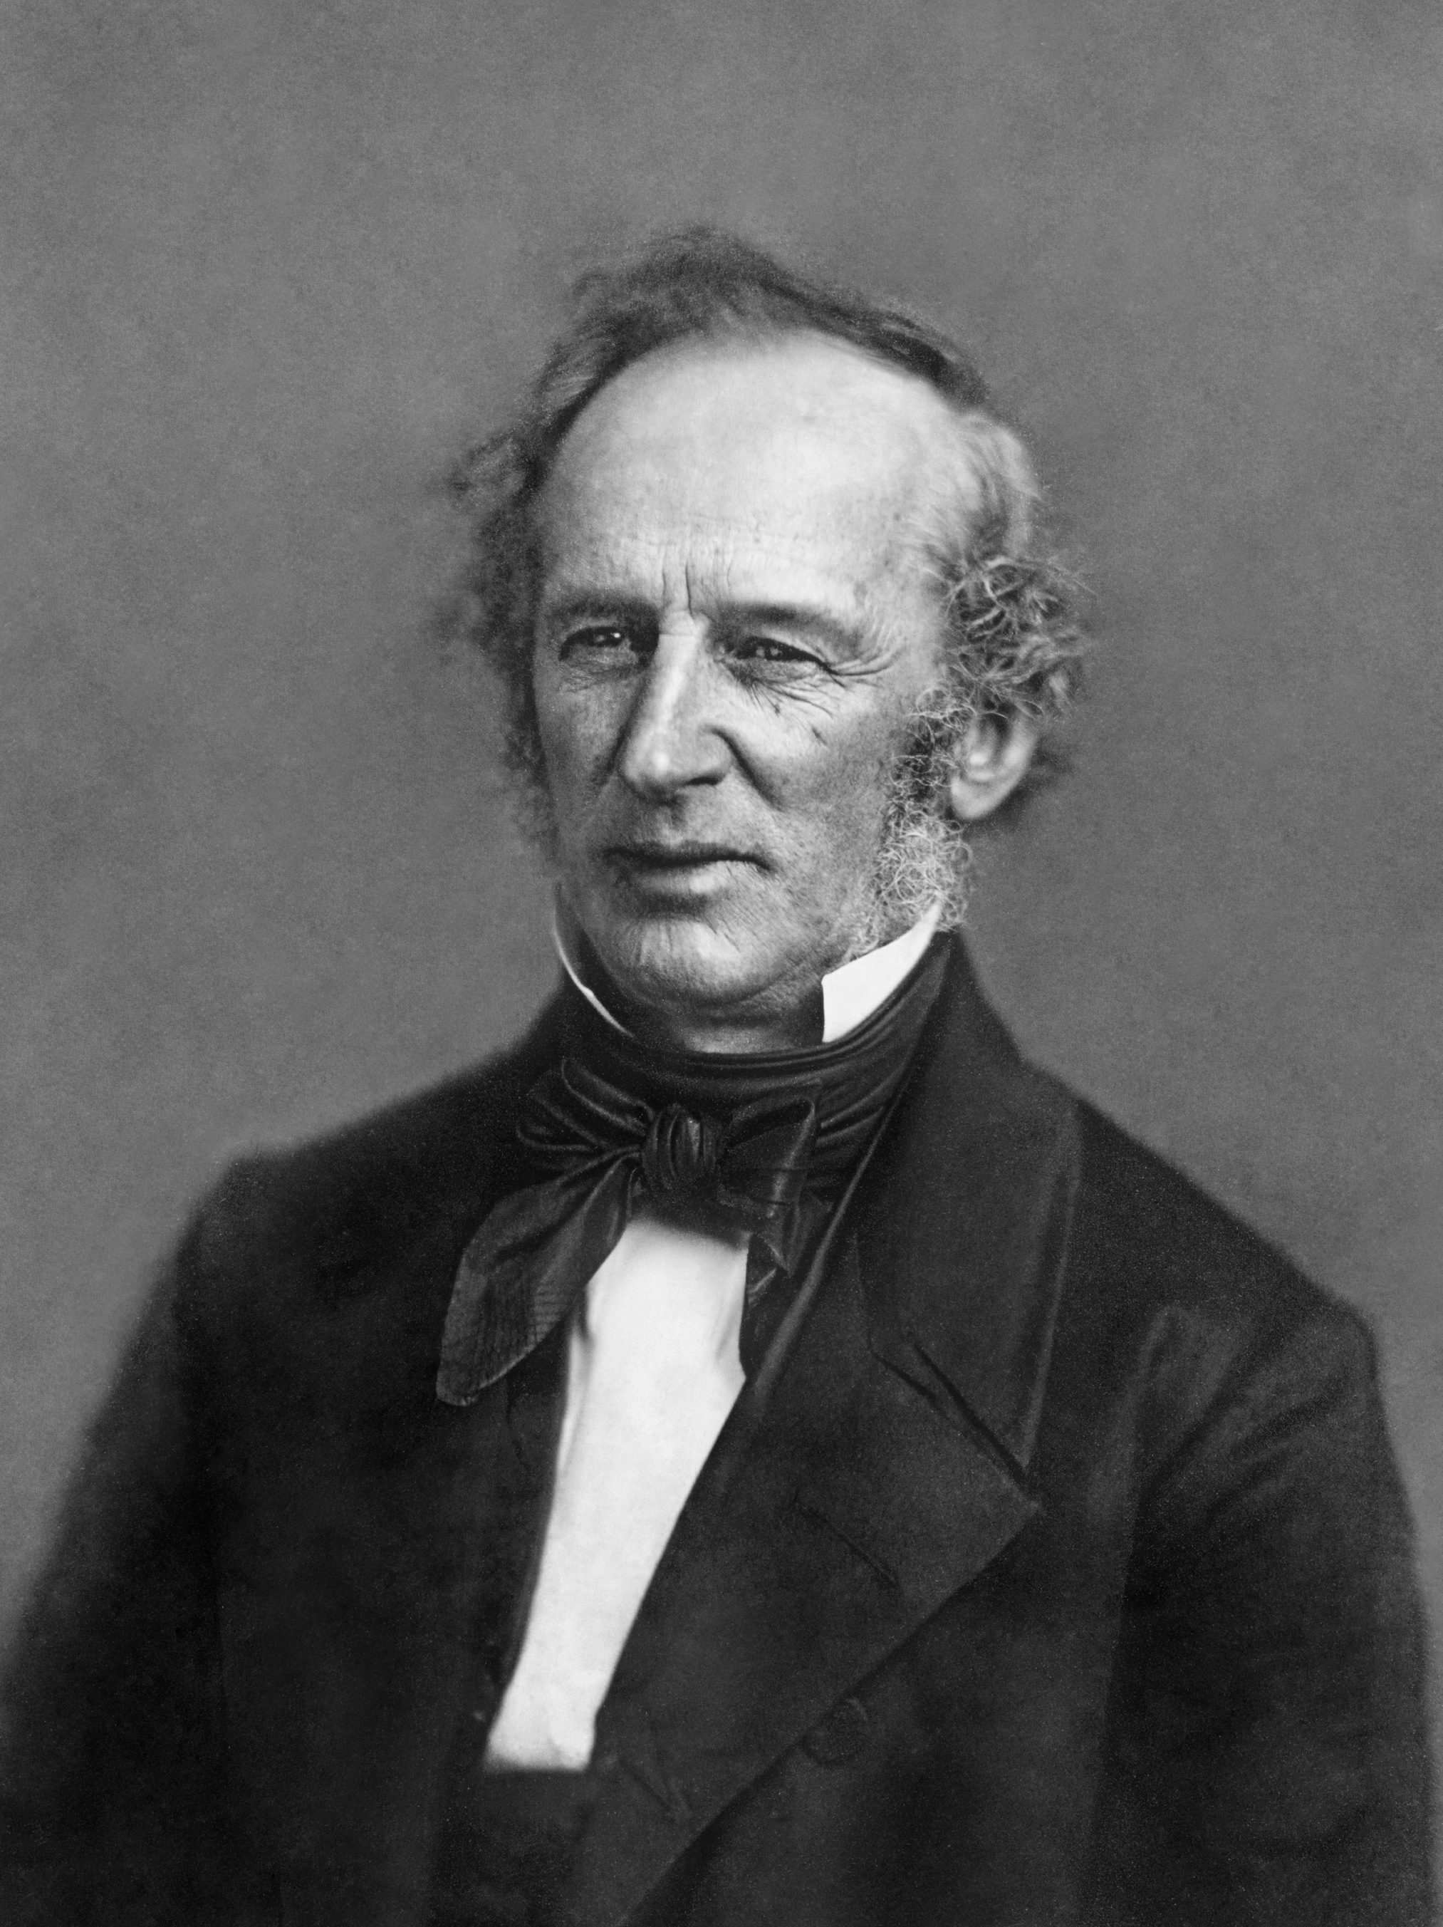
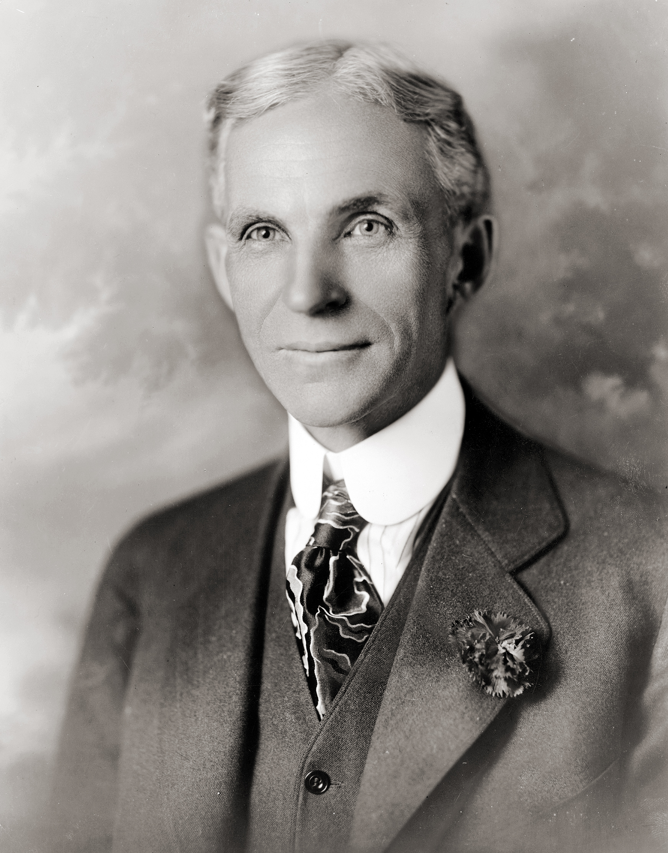
USII.4d Inventions, Big Business, Industry
Big business was often led by Captains of Industry, who were known to be ruthless and incredibly smart:
• John D. Rockefeller (oil)
• Andrew Carnegie (steel)
• Cornelius Vanderbilt (shipping and railroads)
• Henry Ford (automobiles)

Slide 12
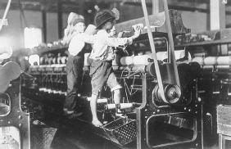
USII.4e Progressive Movement
The negative effects of industrialization led to the rise of organized labor and important workplace reforms. There were three main negative effects of industrialization: child labor, low wages/ long hours, and unsafe working conditions.

Slide 13
USII.4e Progressive Movement
As a result of those negative effects unions began forming across America to fight for workers’ rights (American Federation of Labor). One of the most effective forms that unions fought industrialization was through strikes, such as the Homestead Strike.

Slide 14
USII.4e Progressive Movement
Unions were very effective in winning the rights of workers. Many employees saw improved safety conditions, reduced work hours, and restrictions placed on child labor.

Slide 15
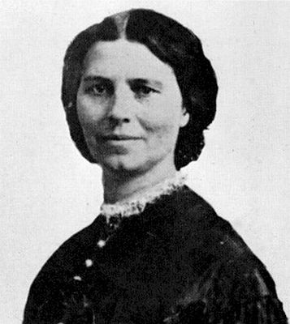
USII.4e Progressive Movement
Unions were not the only groups working toward fighting for equal rights. Women, like Susan B. Anthony and Elizabeth Cady Stanton, were revolting for increased educational opportunities and voting rights (suffrage) across the country. Eventually women won some of the rights they were fighting for. The passage of the 19th amendment finally gave women the right to vote!

Slide 16
USII.4e Progressive Movement
The final reform made was the result of the Temperance Movement. Many groups (mostly made up of women and families) were opposed to the making and consuming of alcohol. The 18th amendment prohibited the manufacture, sale, and transportation of alcoholic beverages.

